Slide 1
SOCIAL MEDIA ANALYTICS HOME WORK -4
BY Ravinthiran Partheepan

Slide 2
Query
To demonstrate the ability to use APIs to extract content from Twitter and YouTube channels:
create a developer account(s) and through that, download data in CSV format from Twitter and YouTube using Python scripts.
explain downloaded data (how it could be used for the marketing purposes).

Slide 3
Technical Aspects
Programming Language Used R Script
Library Used tweetR, Xlsx.

Slide 4
Solution For the Query
First I have Installed ‘tweetR’ Library in R and For Python ‘tweepy, Tweetpony,twypython,Birdy’.
The First Step is Configuring our Twitter Api_Key, Api_Acess, Api_Token_access and Consumer Key.
Then after step 2, with the help of tweetR we can scrape the data from twitter.
I have scraped ‘Heart_Disease’ data from Twitter with count,replyToSN(ID),Created,Truncated.
I have stored the scraped data into XLSX data with the help of XLSX Library.

Slide 5
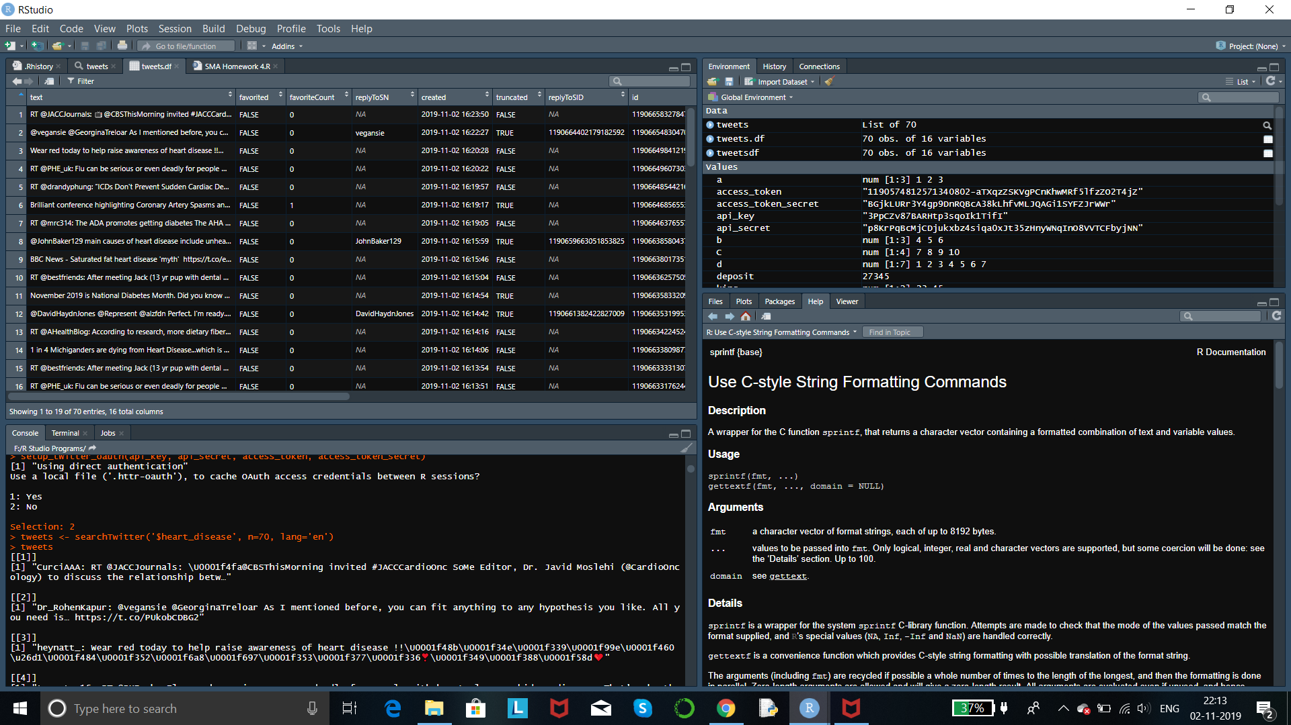
Program Code

Slide 6
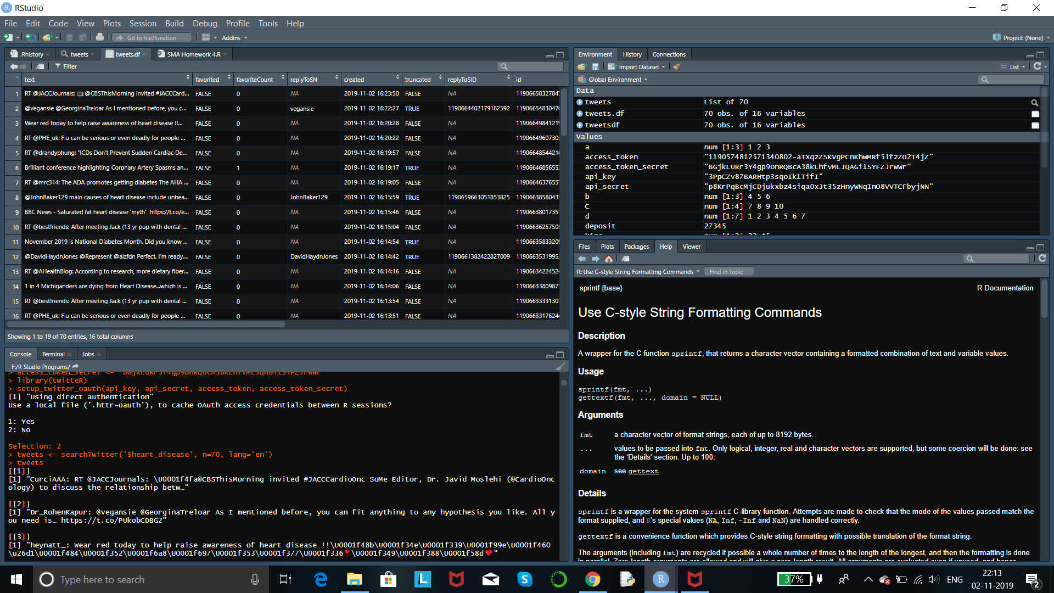
Program Code

Slide 7
Output

Slide 8
Thank You!

